Slide 1
LET’S PUT IT ALL IN THE RIGHT PLACE!
I.D.A. Waste Management Bistrita-Nasaud
4th April 2022

Slide 2
TABLE OF CONTENTS
PREMISES
ECO FURNICUTE 2021
01
02
03
RECYCLE FOR YOUR FUTURE !
An overview of our common goals
Partnership with Secondary School “Stefan cel Mare” Bistrita
A project for 10 schools in the county

Slide 3
PREMISES
I.D.A. Bistrita-Nasaud runs advertising campaigns regarding the correct separation of the waste;
The main message of the campaign is “LET’S PUT IT ALL IN THE RIGHT PLACE”

Slide 4
PREMISES
Everyone agrees that education on environmental protection and waste recycling should start at an early age;
At this age the mentality can be shaped in the spirit of recycling for a sustainable and clean environment
All recycling and greening actions carried out in partnership with schools have been successful;
Unfortunately, the situation of the COVID pandemic has severely affected these activities in the last 2 years;

Slide 5
ECO FURNICUTE PROJECT 2021

Slide 6
ECO FURNICUTE 2021
In 2021, IDA Waste Management Bistrița-Năsăud supported the Eco Furnicute project of “Ștefan cel Mare” Bistrița Secondary School
In this project, the children were encouraged to collect the recyclable waste and bring it to school by creating a virtual currency, which would reward their efforts - "Furnicoin".
In the project, more than 1 ton of paper / cardboard and several hundred kilos of plastic / metal were collected separately by the effort of a single class;
The impact of their action - 1 ton of recycled paper / cardboard means saving 17 adult trees;

Slide 7
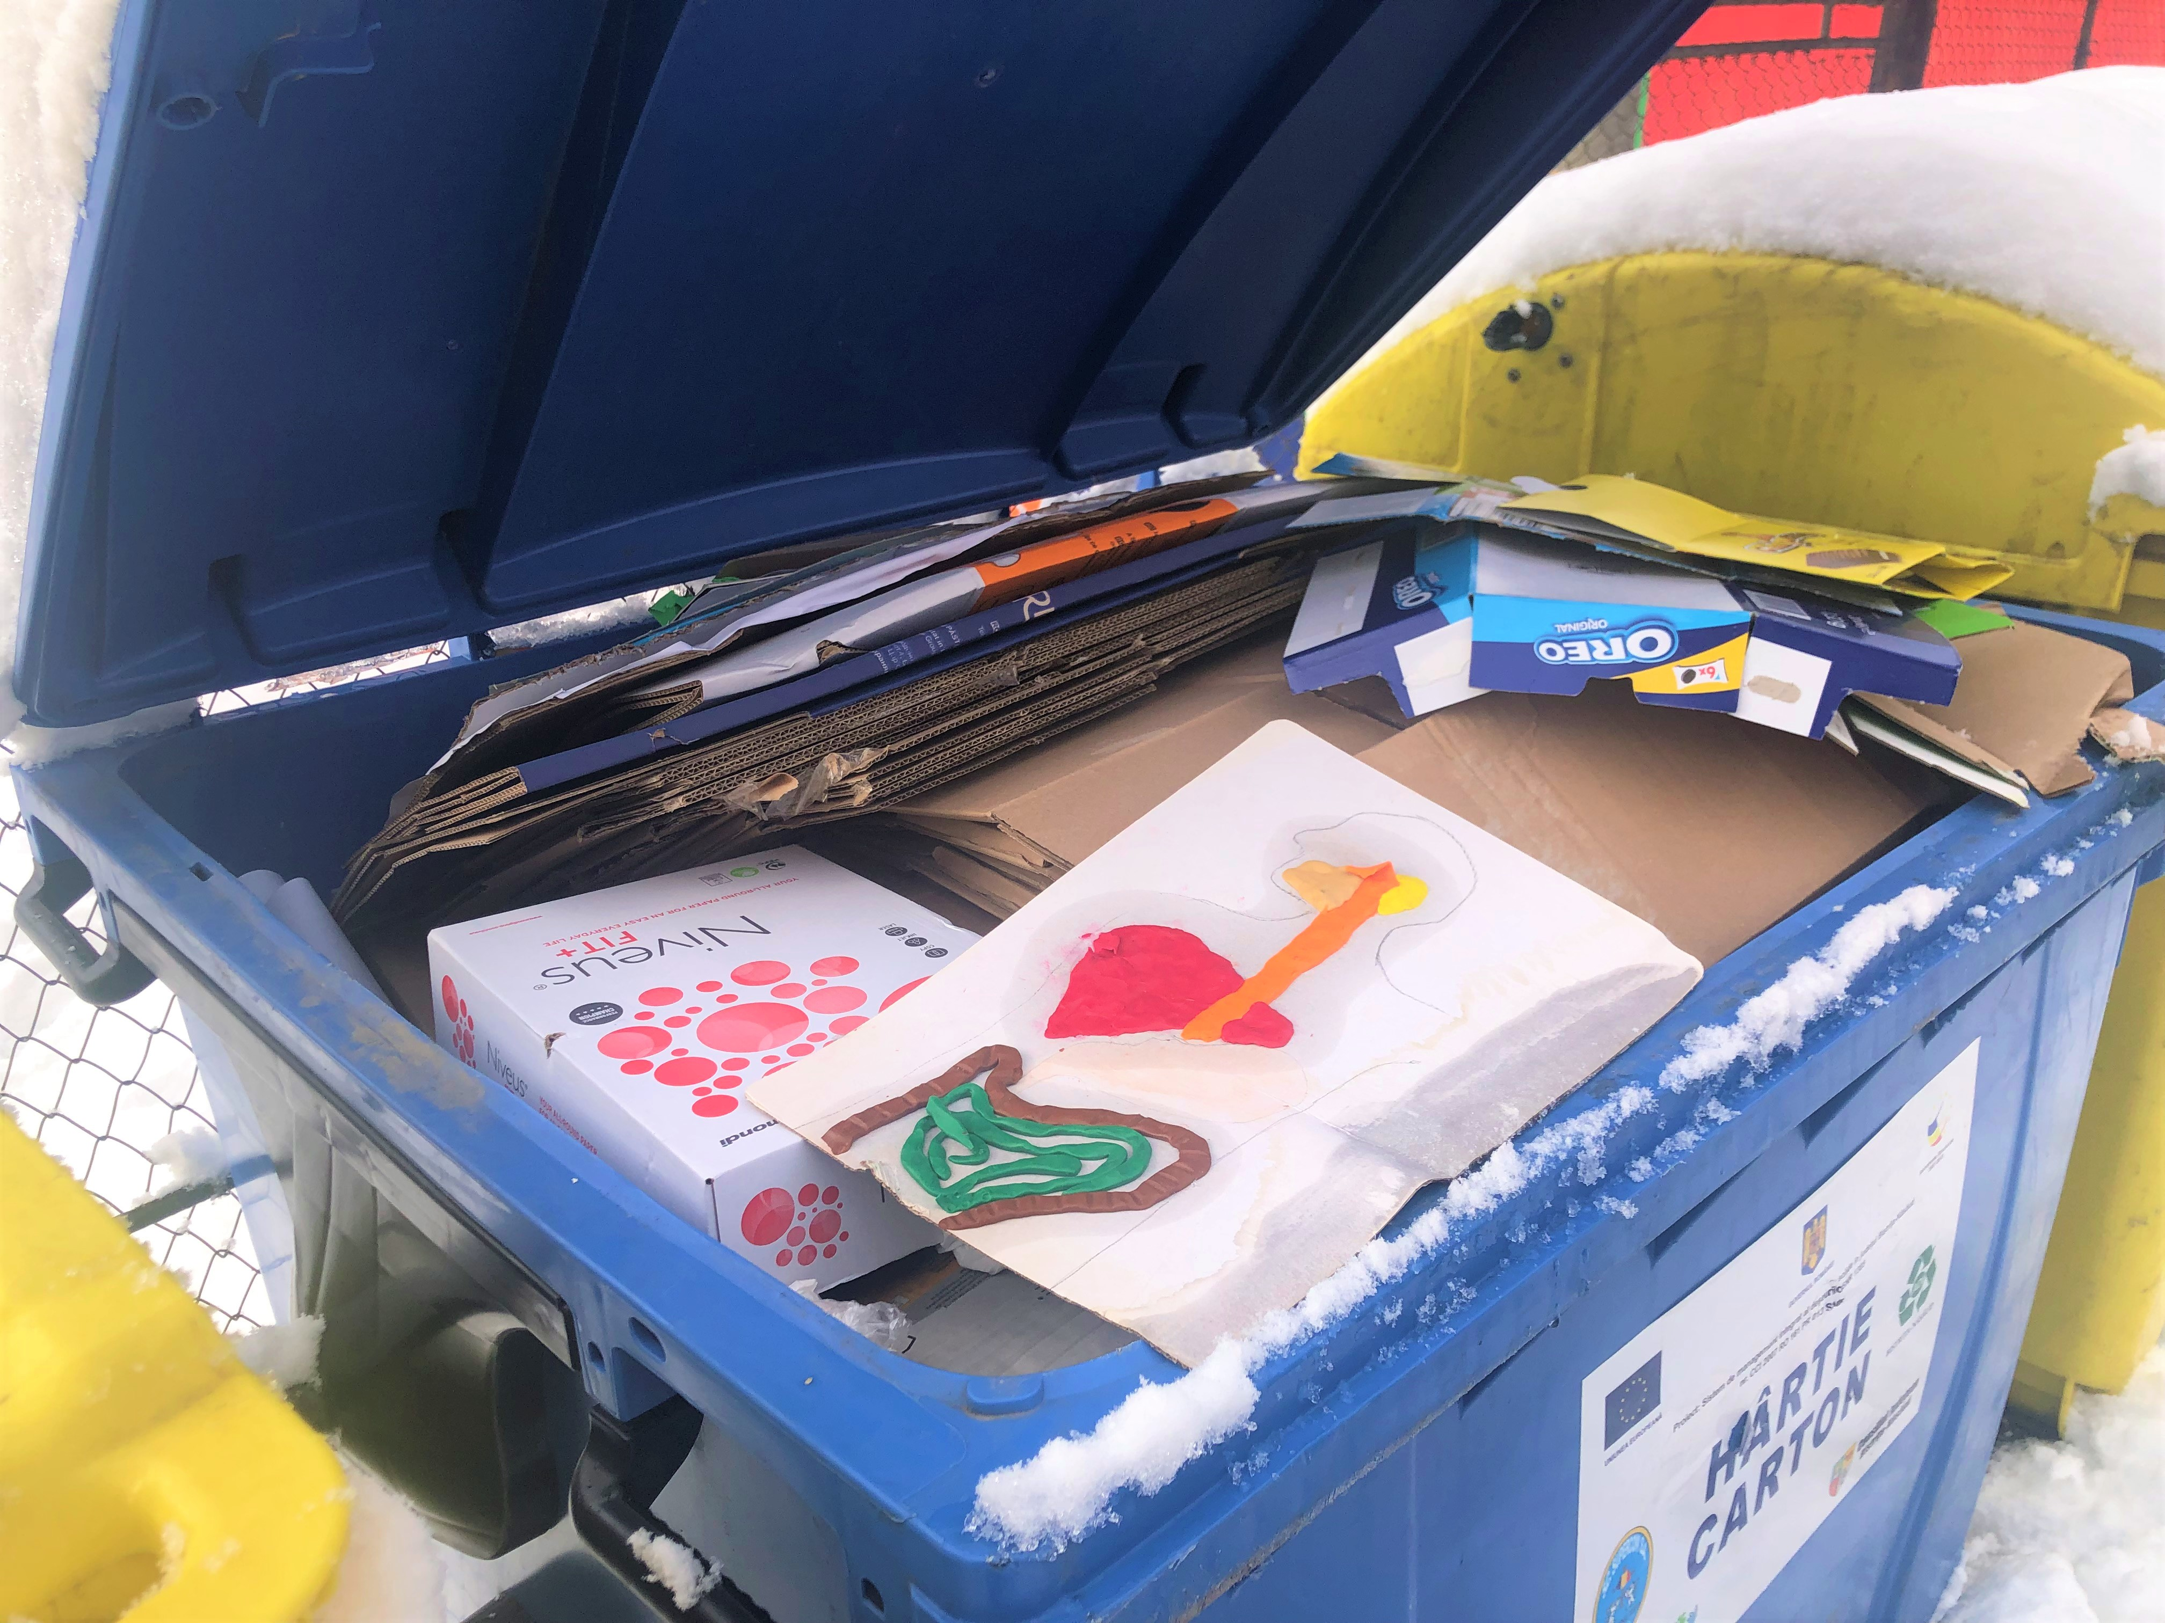
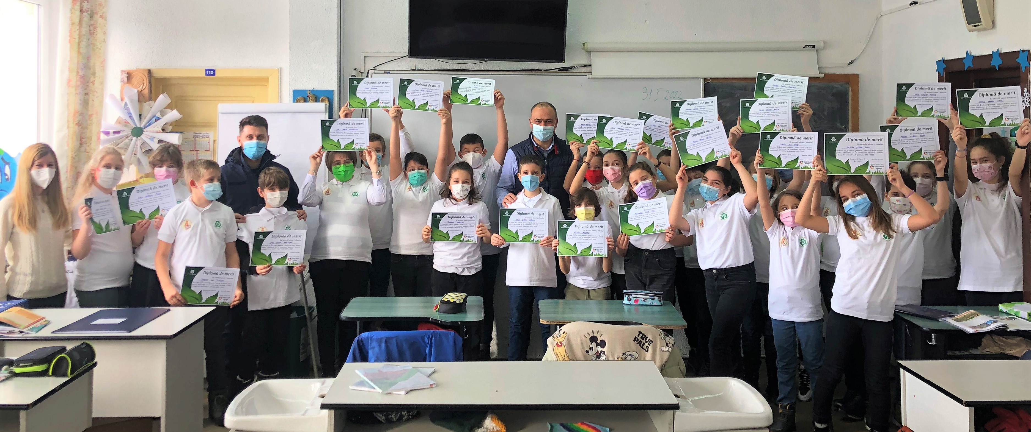
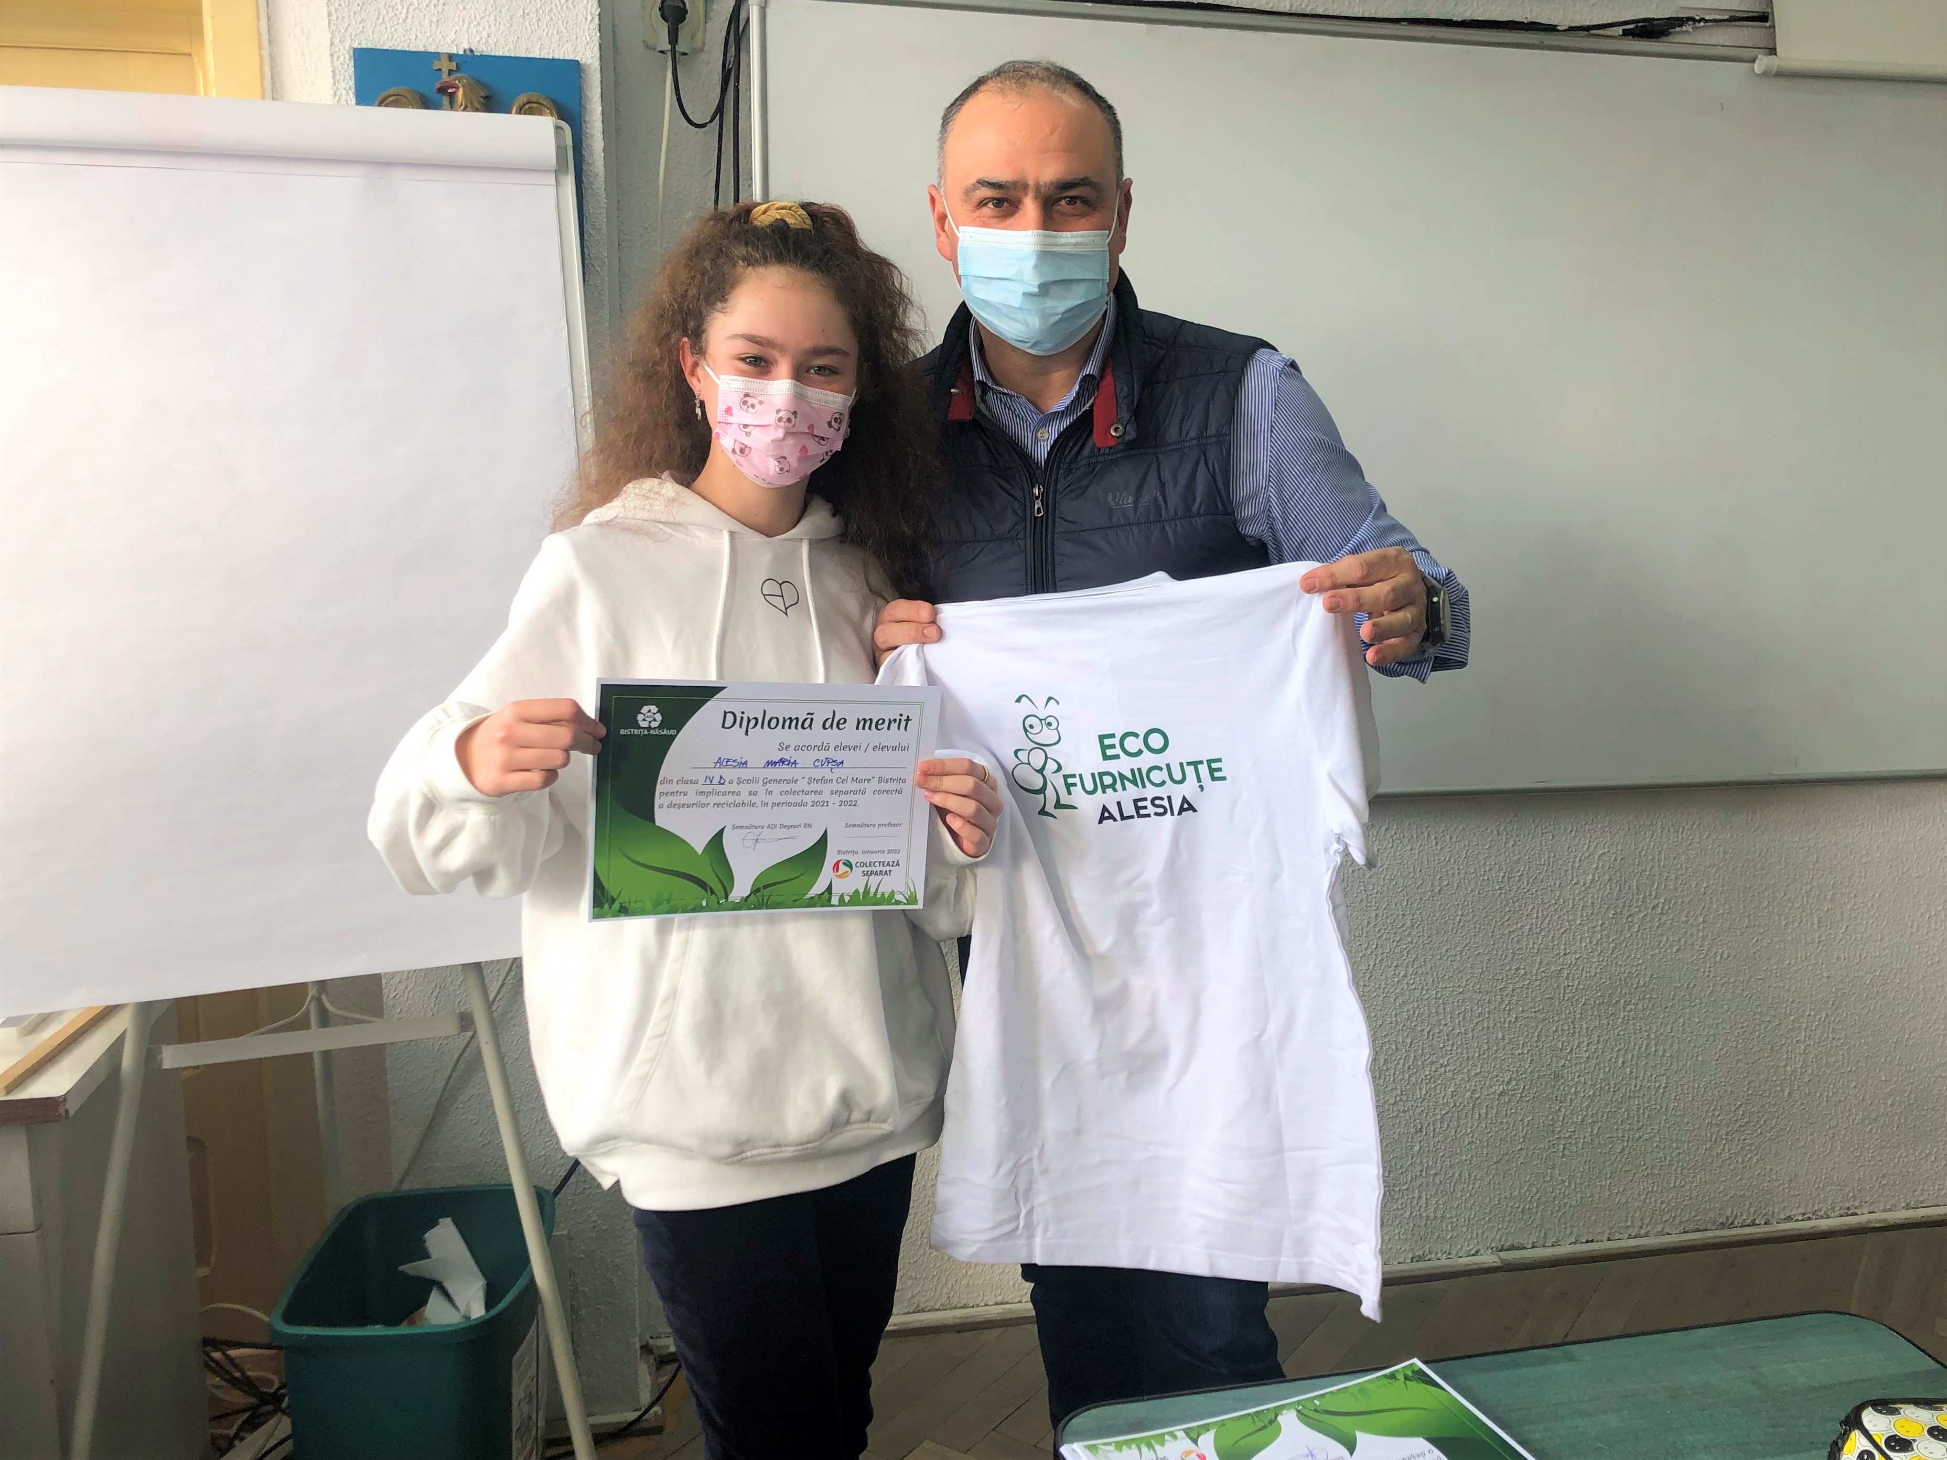
ECO FURNICUTE
BISTRITA 2021

Slide 8
RECYCLE FOR YOUR FUTURE 2022

Slide 9
RECYCLE FOR YOUR FUTURE! 2022
Project started in 2022 for 10 educational units from Bistrița-Năsăud county in partnership with the local town halls and the County School Authority
The project takes place between March - June 2022 and is focused on primary and secondary school - in order to include schools in rural areas;
For the children's effort to collect recyclable waste separately, prizes will be awarded consisting of 1 bicycle, 10 sets of headphones and 10 portable speakers;
The project was started in Galații Bistriței, and will be implemented in 9 other educational units in the county - both in urban and rural areas
In October 2022 we will resume this project with another 10 educational units at county level;

Slide 10
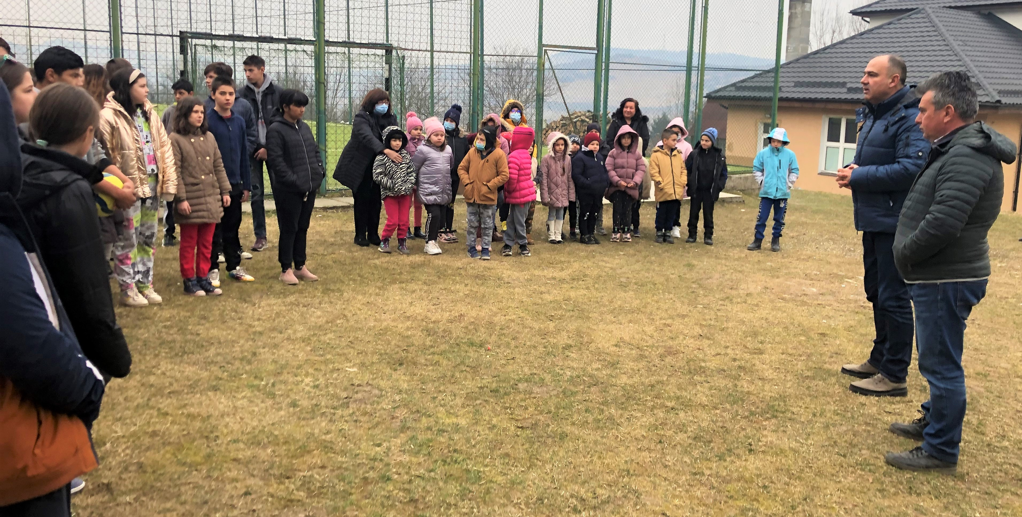
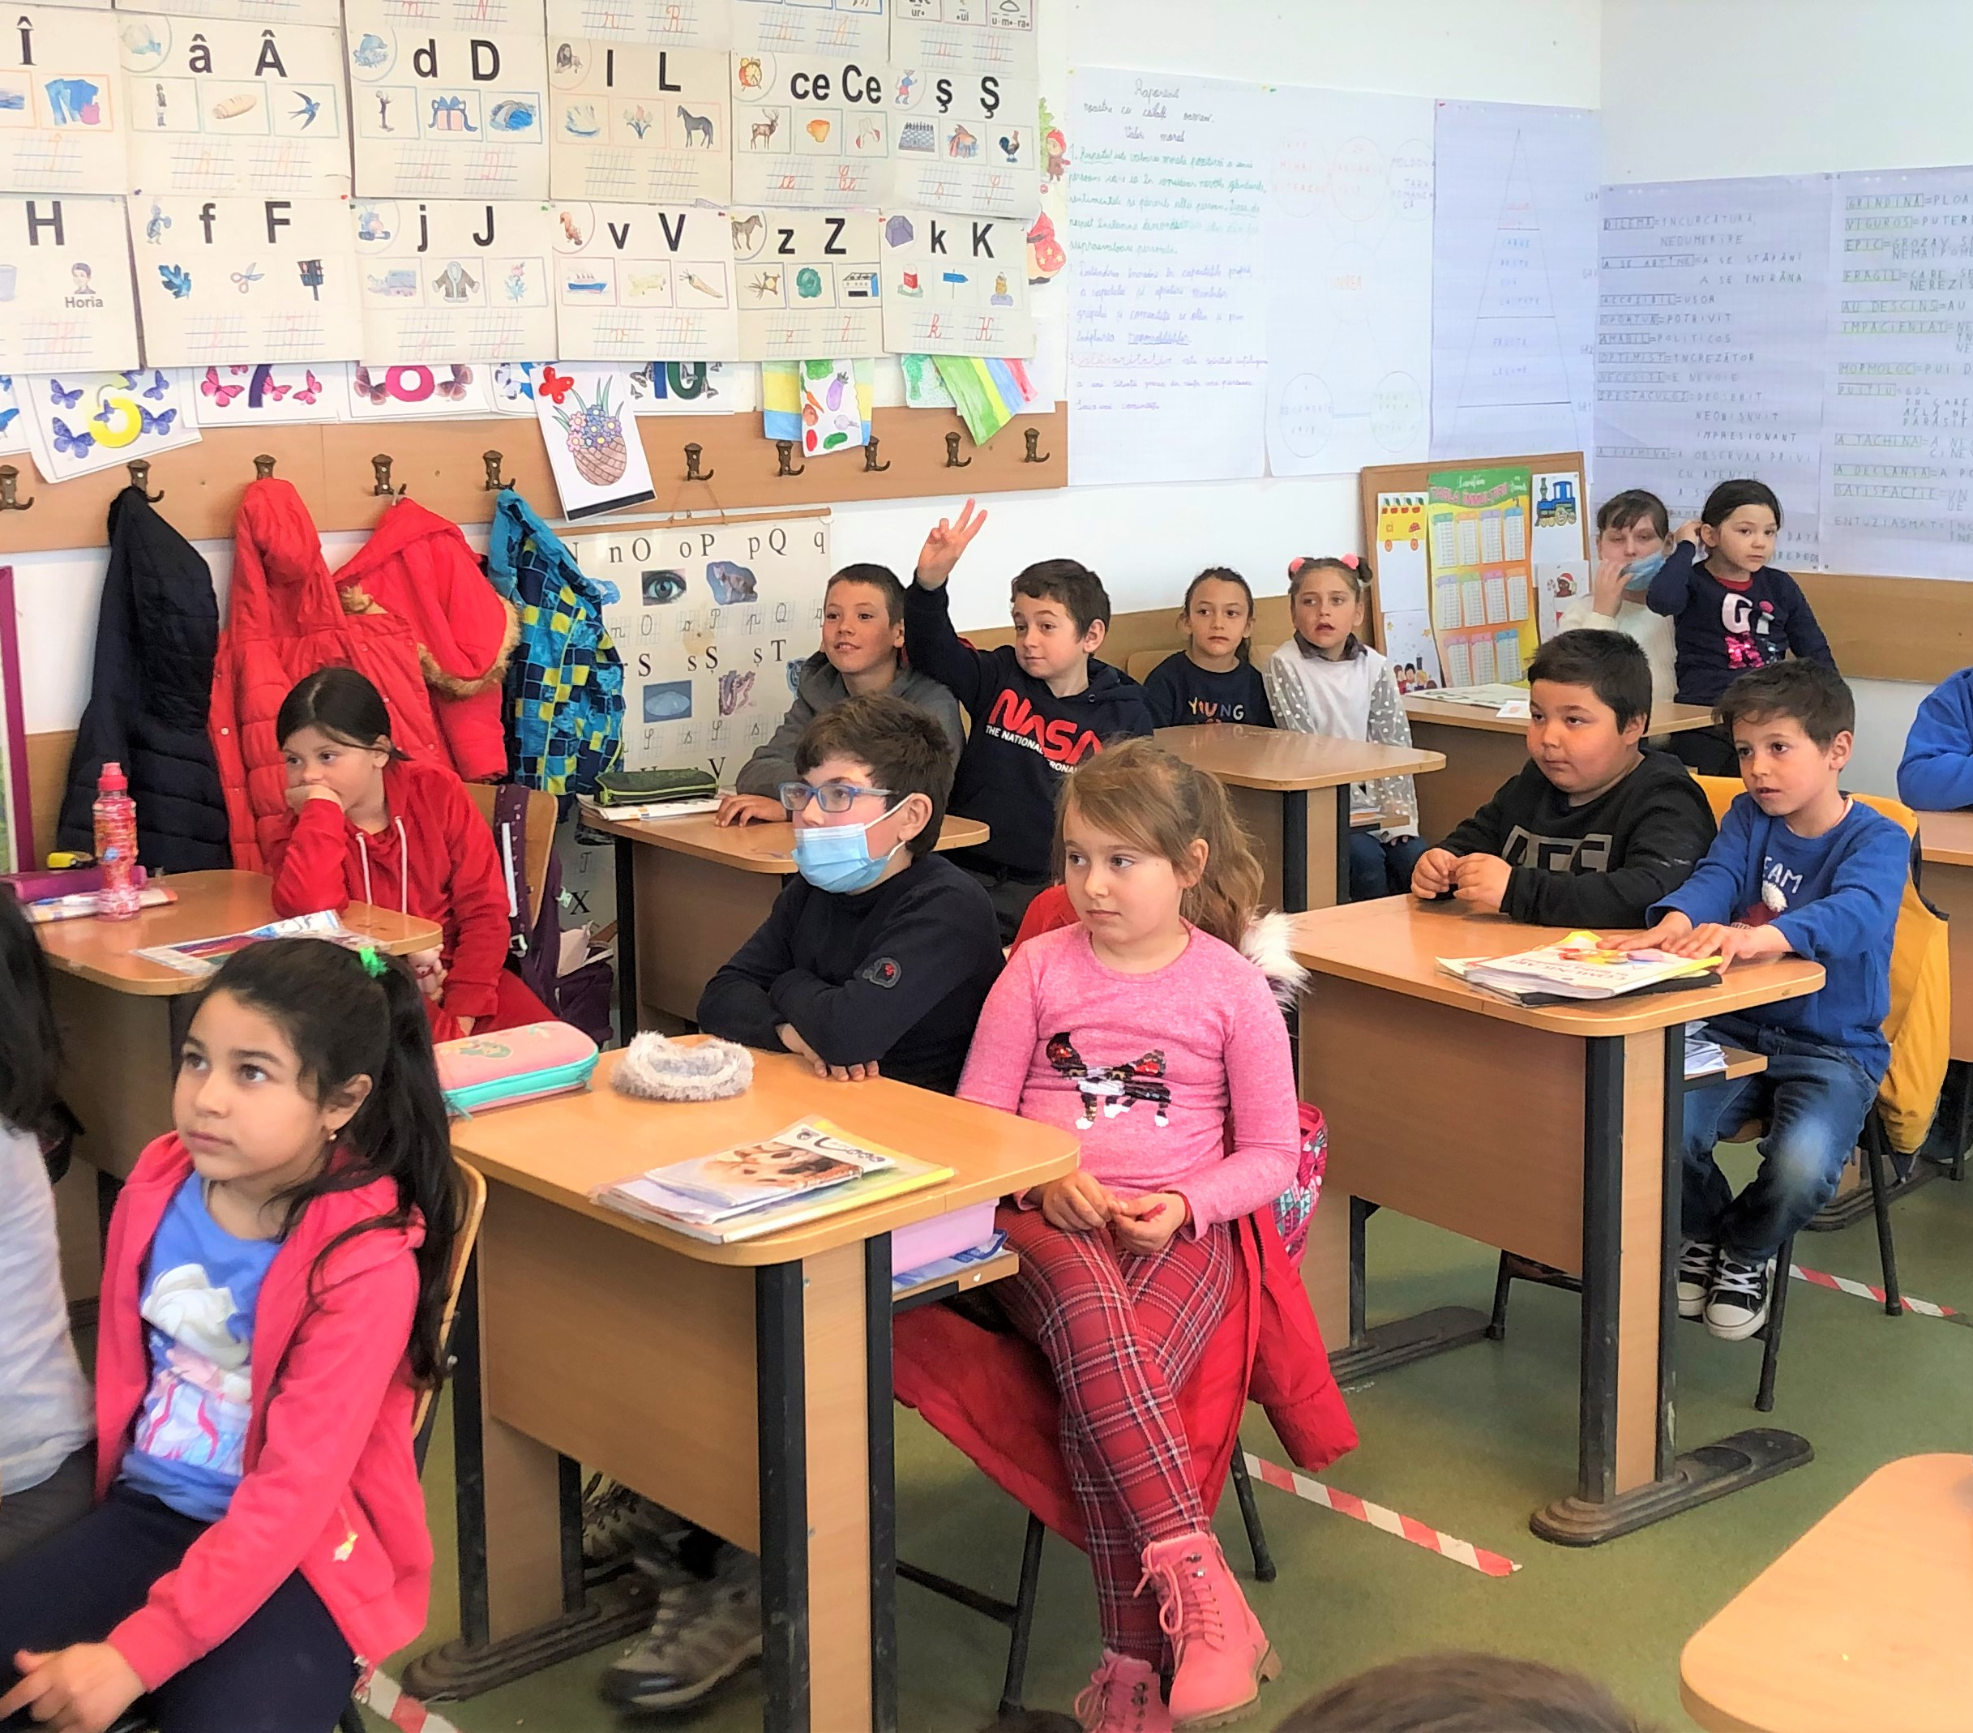
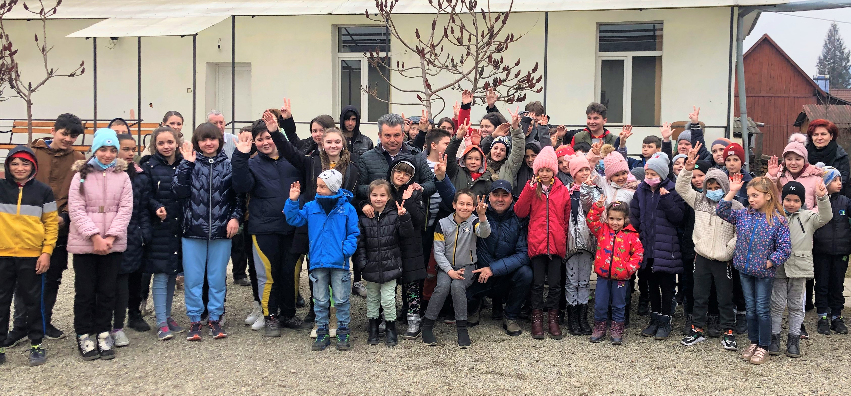
RECYCLE FOR YOUR FUTURE 2022

Slide 11
I.D.A. Waste Management Bistrita-Nasaud is open to any form of partnership with educational institutions in the county, in order to promote and inform children about the importance of recycling the waste.

Slide 12
Thank you!

